Slide 1

Default payments of credit card clients
Abhinandan Rai
Bhramini Das
Kevin V Kurian
Udhaya Prasanth
Yuvaraj Subramanian
Mentor – Ram Kumar

Slide 2

Project objective
The fundamental objective of the project is to analyze credit card data collected from Taiwan-based credit card issuer and predict whether or not a consumer will default on their credit cards, as well as identify the key drivers behind this. This would inform the issuer’s decisions on who to give a credit card.

Slide 3

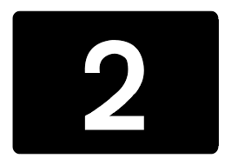

Literature review
Sudhamathy G and Jothi Venkateswaran Analytics Using R for Predicting Credit Defaulters designed the decision tree-based classification model to predict the defaulters
Jacob Studied the most useful features and examined those features for prediction and accuracy of Random Forest Ensemble method which in turn showed the highest rate in predicting credit card defaulters
Yeh and Lien Studied the probability of credit card customers default, their finding suggested that artificial neural network was best outperforming machine learning algorithm.

Slide 4

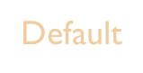

DATA DICTIONARY (Categorical)
Marriage
Age
Sex
1 – Married
2 – Single
3 – Others
Age in Years
1 – Male
2 – Female
Education
Repayment History
1 – Graduate School
2 – University
3 – High School
4 – Others
PAY_1 – September
PAY_2 – August
PAY_3 – July
PAY_4 – June
PAY_5 – May
PAY_6 – April

Slide 5
DATA DICTIONARY (Numerical)
Limit Balance
Bill Amount
Pay Amount
Amount of given credit in Taiwan dollars
BILL_AMT1 – September
BILL_AMT2 – August
BILL_AMT3 – July
BILL_AMT4 – June
BILL_AMT5 – May
BILL_AMT6 – April
PAY_AMT1 – September
PAY_AMT2 – August
PAY_AMT3 – July
PAY_AMT4 – June
PAY_AMT5 – May
PAY_AMT6 – April

Slide 6
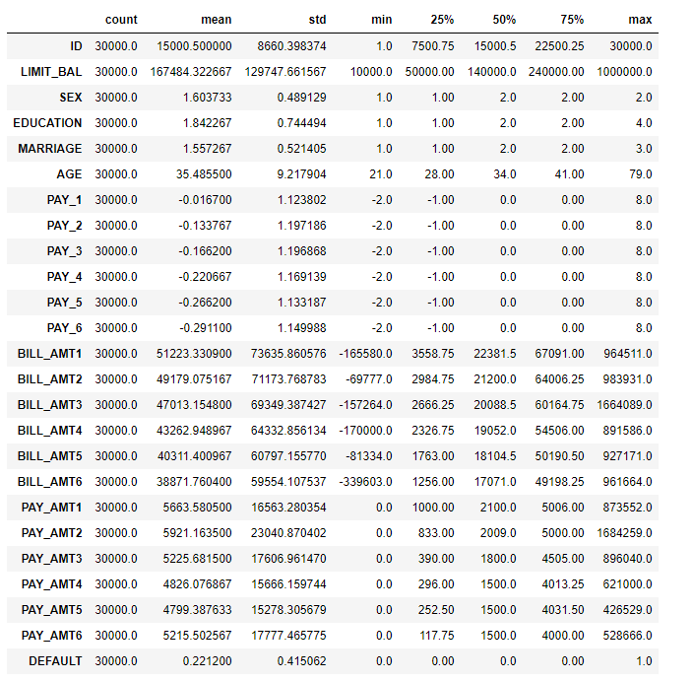
Statistical overview
There are 30000 distinct id's in the dataset which means 30000 credit card holders and the average credit limit amount is 167,484.32 with std. 129,747.66 where the highest amount is 1000000.
Most of the card holders are either graduate school or university. Most of the credit card holders are either married or single
Credit card holders age ranges from 21 to 79 and the average age is 35.48 with standard deviation 9.21
Target column which includes two distinct values 0 and 1 where 0 for default payment means "not default" and 1 means "default", and the mean is 0.221 which means that there are 22.1% card holders who will default next month.

Slide 7
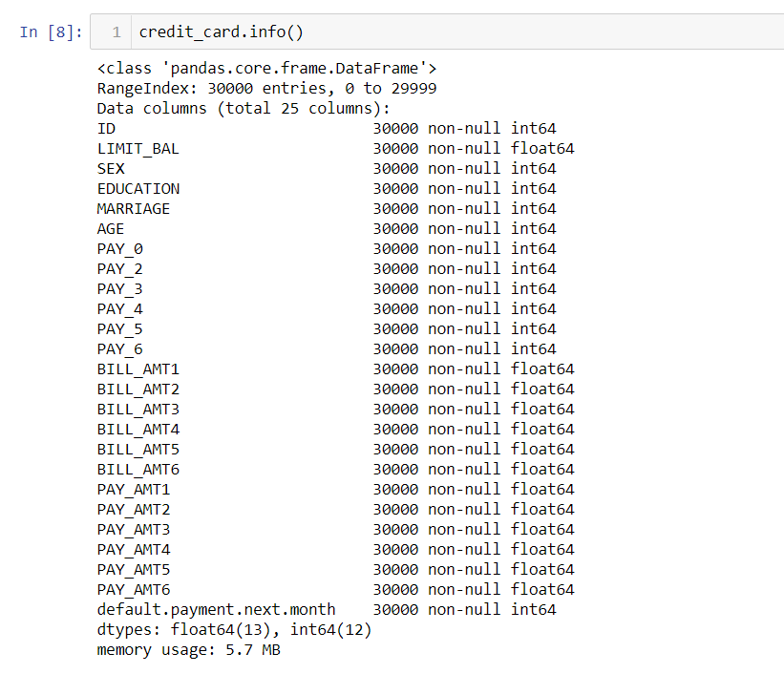
Concise summary
There are total of 25 columns and 30000 records in the dataset and none of the columns has null values.
There are 14 continuous columns and 11 categorical columns in the dataset.
Though there are no null values in the dataset there were some unknown classified records which were are being pre processed before building the base model

Slide 8
Pre processing
Data pre-processing is done to enhance the quality of data, to promote extraction of meaningful insights from the data. In simpler words, cleaning and organizing the raw data to make it suitable for building and training machine learning models. It is a data mining technique that transforms raw data into an understandable and readable format.
Below are some of the pre-processing done :
1.Records in ‘EDUCATION’ are carrying redundant information with different labels. Since labels 0, 4, 5, 6 all carry same information either other or unknown, it is better to group labels together and name it 4.
2.Similarly,label 0 in ‘MARRIAGE’ can be safely categorized as 'Other' under label 3.
3.Column 'default.payment.next.month' is renamed as 'DEFAULT' for better accessibility.
4.Column 'PAY_0' would be better to name it 'PAY_1', to make it consistent with 'BILL_AMT1' and 'PAY_AMT1'.

Slide 9
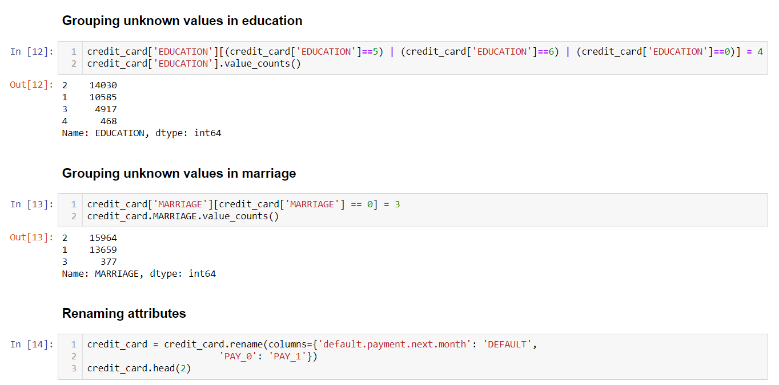
Pre processing

Slide 10

Exploratory data analysis
Exploratory data analysis (EDA) is an approach to analyze data sets and to summarize their main characteristics, often with visual methods.
It refers to the critical process of performing initial investigations on data so as to discover patterns, to spot anomalies, to test hypothesis and to check assumptions with the help of summary statistics and graphical representations.
It is a good practice to understand the data first and try to gather as many insights from it. EDA is all about making sense of data in hand, before getting them dirty with it.

Slide 11
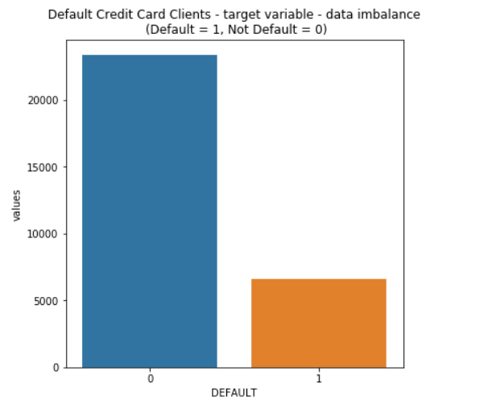
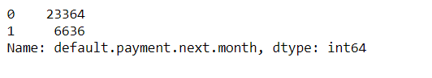
Exploratory data analysis
A number of 6,636 out of 30,000 (or 22%) of clients will default next month. The data has not a large imbalance with respect of the target value
Resampling methods needs to be applied to increase the percent of defaulters in order to achieve better model training results.

Slide 12
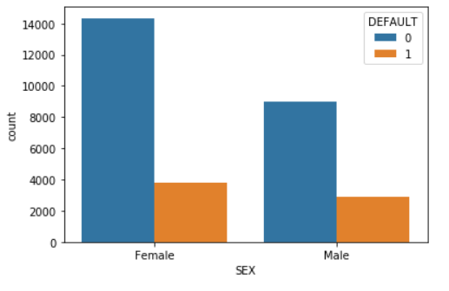
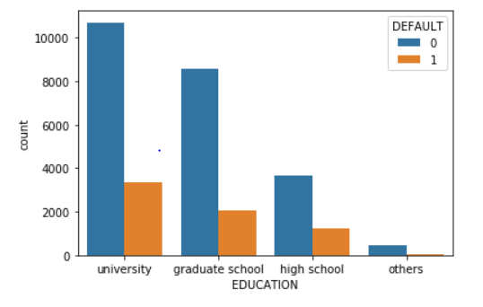
UNI variate analysis
From the above graph, it is evident that Female non-defaulters were higher than male non-defaulters.
The people with qualification from university have more non-defaulters comparing to other education levels

Slide 13
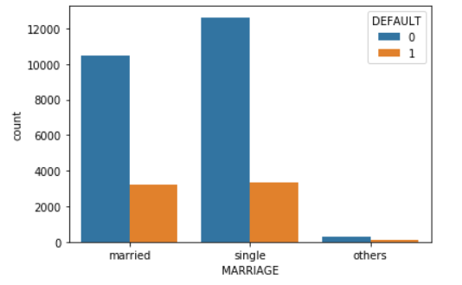
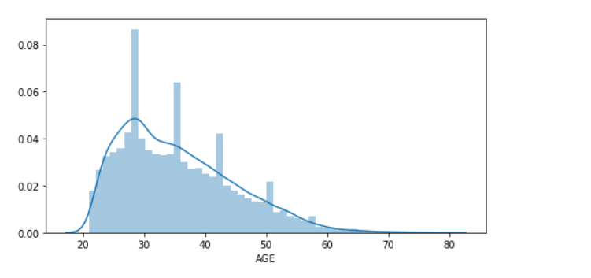
UNI variate analysis
From the graph it is evident that people who have marital status as single have more non-defaulters compared to married people
The age is right skewed which refers, more number of credit card holders were between the age group 20-35

Slide 14
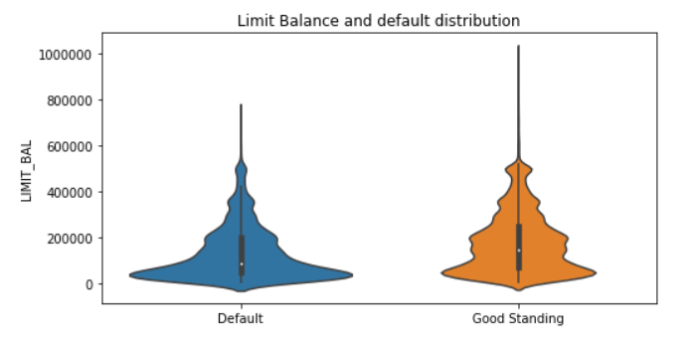
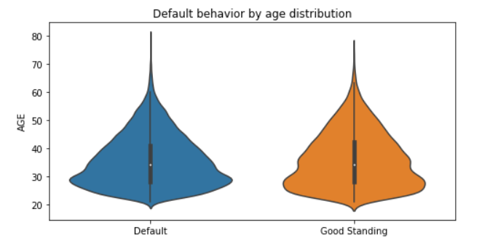
UNI variate analysis
From plot 1, we can infer that median of the limit balance is around 100k dollars but most
population is concentrated in below that. Which in turn infers that most of the defaulters are from middle class
people.
From plot 2, we can see the age distribution of both default and good standing card holders are similar
It is difficult to predict whether a person is defaulter or not with age.

Slide 15
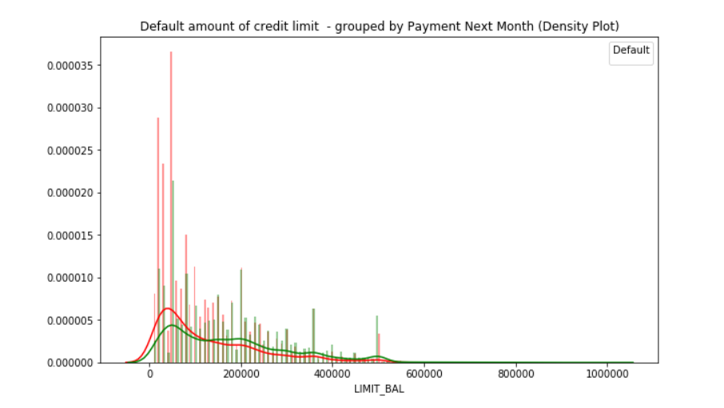
UNI variate analysis
The Spikes in the above plot beautifully visualizes that the largest number of credit cards are with limit of
50,000 (3365), followed by 20,000 (1976) and 30,000 (1610).
The above plot shows the relationship between a person's balance limit and default. Generally a higher
percentage of people with lower limit balances will end up defaulting.

Slide 16
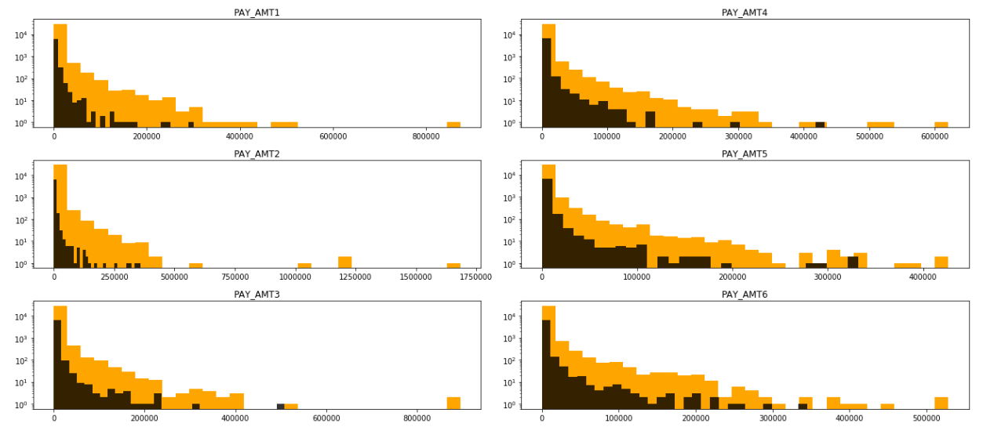
Payment Amount
The distribution is right skewed, and it signifies that a lot of people have paid lower amounts in a lower range and less than 10% defaulter above 200k dollars.

Slide 17
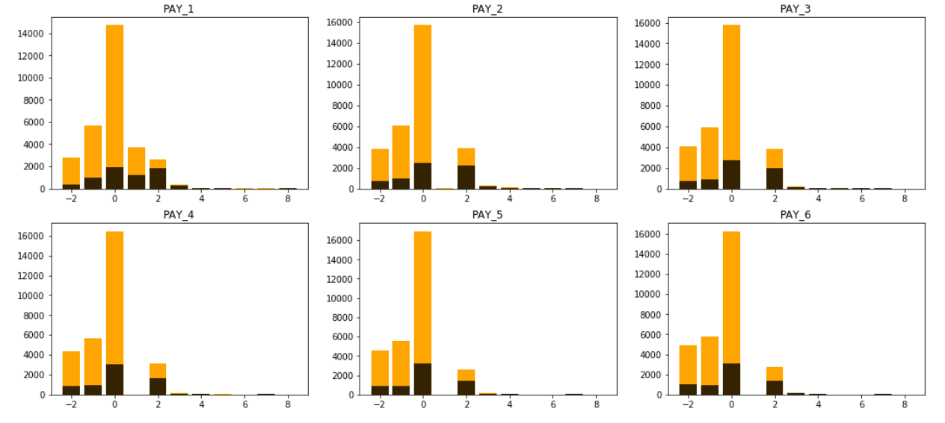
Payment STATUs
Most of the credit card holders have paid at least their minimum due amount
Clearly we can see that as the payment delay increases chances of Default increase too.
People who are paying on time for any given month we can't guarantee he will not default.

Slide 18
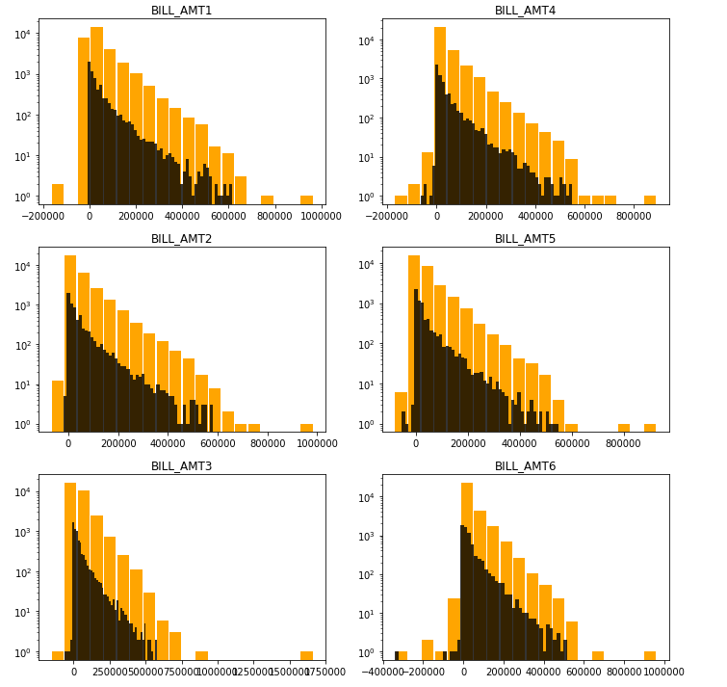
Bill Amount
All the bill amounts are right skewed. There are a lot of people concentrated in the lower balance limit and the spread on the higher balance limit is wide. This is why the bill amounts are right skewed.

Slide 19
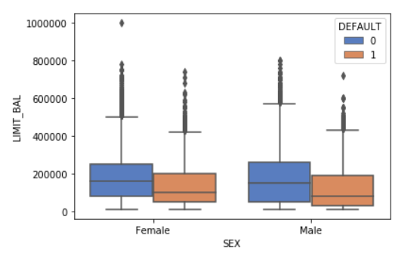
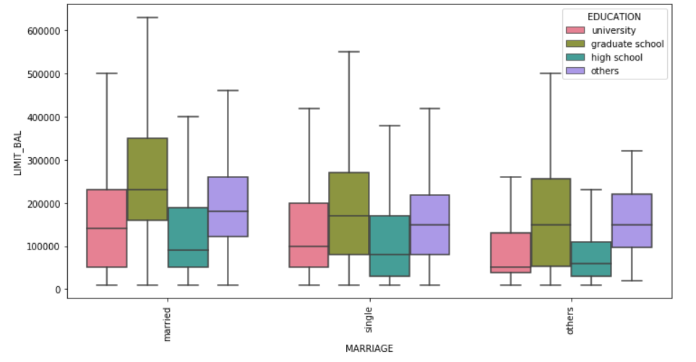
MULTIVARIATE analysis
Female have slightly higher median limit balance compared to male
Card holders who are married and educated from graduate school have higher limit balance.
Others(Divorced & Widows) and education from high school have the least range of limit balance compared to single and married.

Slide 20
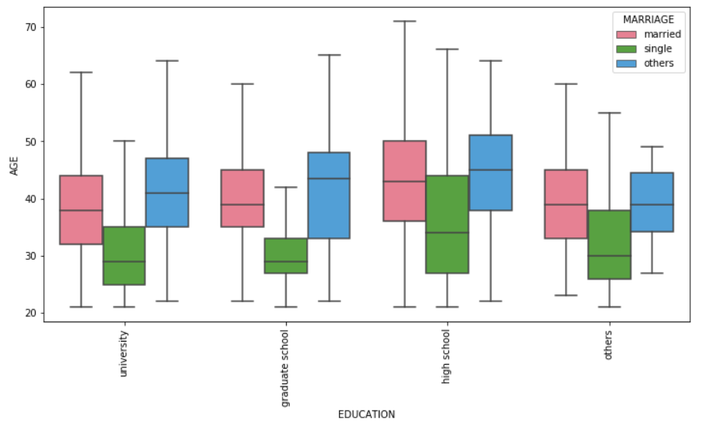
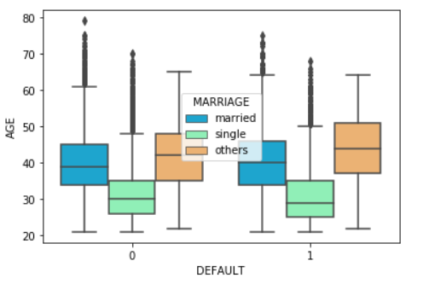
MULTIVARIATE analysis
Credit card holders of high school education are mostly from higher age group compared to other age groups.
Credit holders whose all type of marital status have same median age of both defaulters and non-defaulters.

Slide 21
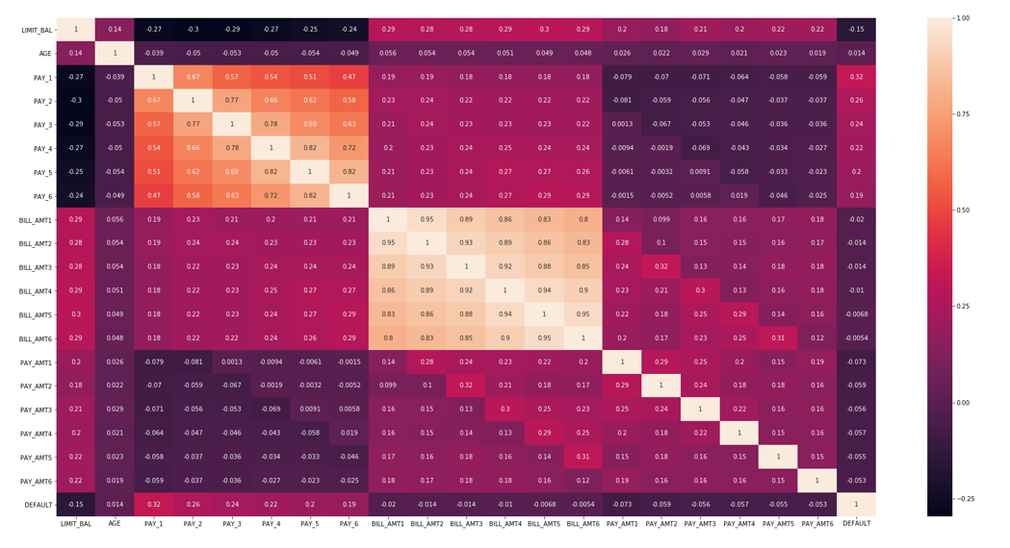
Heat Map

Slide 22
Inference
From the heat map, Highest correlation observed to the outcome variable is 0.32 with PAY_1 which indicates a positive correlation represents longer the period of delay payment, higher the chances of being a defaulters.
There is a strong multi collinearity exists among repayment status features (PAY1 ~ PAY6) and bill amount features (BILL_AMT1 ~ BILL_AMT6). Other than this there are no other significant correlation observed.
There is a positive correlation between limit balance, bill amount and payment amount as limit balance increase bill amount and payment amount increases
There is a negative correlation between limit balance and pay status, as pay status increases there is a delay in payment which in turn reduces the credit score and this limits the limit balance to a lower amount.

Slide 23
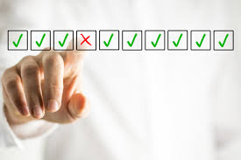
Feature selection
Feature Selection is the process where we automatically or manually select those features which contribute most to your prediction variable or output in which you are interested in. Having irrelevant features in data can decrease the accuracy of the models and make your model learn based on irrelevant features.

Slide 24
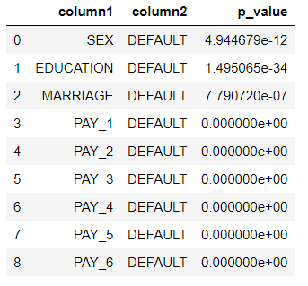
Chi-Square test for categorical data
To check whether there is an association (or relationship) between 2 categorical variables (target column and independent features) we have used chi-square test and our null and alternate hypothesis are as:
H0: No relationship between 2 categorical variables
H1: Relationship between 2 categorical variables

Slide 25
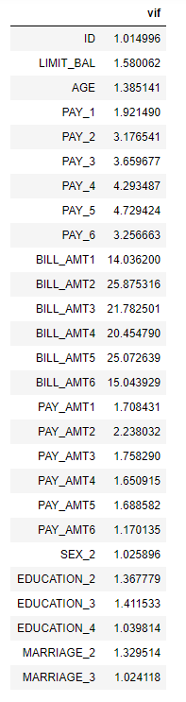
Multicollinearity test
Multicollinearity occurs when there is high correlation among predictor variables. We have analysed multicollinearity using (variance inflation factor) VIF to check correlation among predictor variables. The VIF is just 1/(1- R2).
After taking threshold value of 10, we found that BILL_AMT1, BILL_AMT2, BILL_AMT3, BILL_AMT4, BILL_AMT5, BILL_AMT6 are highly correlated.

Slide 26
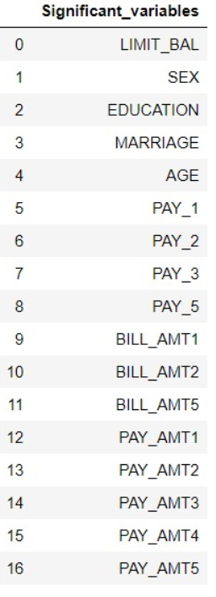
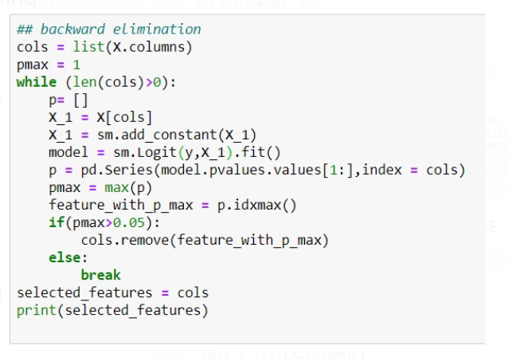
Backward Elimination
In backward elimination, we start with all the features and removes the least significant feature at each iteration which improves the performance of the model. We repeat this until no improvement is observed on removal of features.

Slide 27

Let's create a baseline of performance on this problem and spot-check a number of different algorithms. We will select a suite of different algorithms capable of working on this classification problem. The six algorithms selected include:
Linear Algorithms: Logistic Regression (LR)
Nonlinear Algorithms: Decision Trees, Support Vector Machines (SVM), Gaussian Naive Bayes (NB) and k-Nearest Neighbors (KNN).
BASE Algorithm Evaluation
The Assumptions for the various models are:
SVM
There are no model assumptions to validate for SVM.
Tree Based models
For tree-based models such as Decision Trees, Random Forest & Gradient Boosting there are no model assumptions to validate.
Unlike OLS regression or logistic regression, tree-based models are robust to outliers and do not require the dependent variables to meet any normality assumptions.
KNN
KNN is an non parametric lazy learning algorithm. That is a pretty concise statement. When you say a technique is non parametric , it means that it does not make any assumptions on the underlying data distribution.
Naïve Bayes
In case of Naive Bayes Classifier an assumption is that the predictors/features are independent. Another assumption made here is that all the predictors have an equal effect on the outcome.
20

Slide 28

Logistic Regression
BASE Algorithm Evaluation
The logistic regression assumptions are quite different from OLS regression in that:
1.There is no need for a linear relationship between the independent and dependent variables.
2.There is no need for residuals to be normal.
3.There is no need to meet the homoscedasticity assumption
4.So what are the assumptions that need to be met for logistic regression?
Assumption 1: Appropriate dependent variable structure
This assumption simply states that a binary logistic regression requires your dependent variable to be dichotomous and an ordinal logistic regression requires it to be ordinal.
In addition, the dependent variable should neither be an interval nor ratio scale.
20

Slide 29
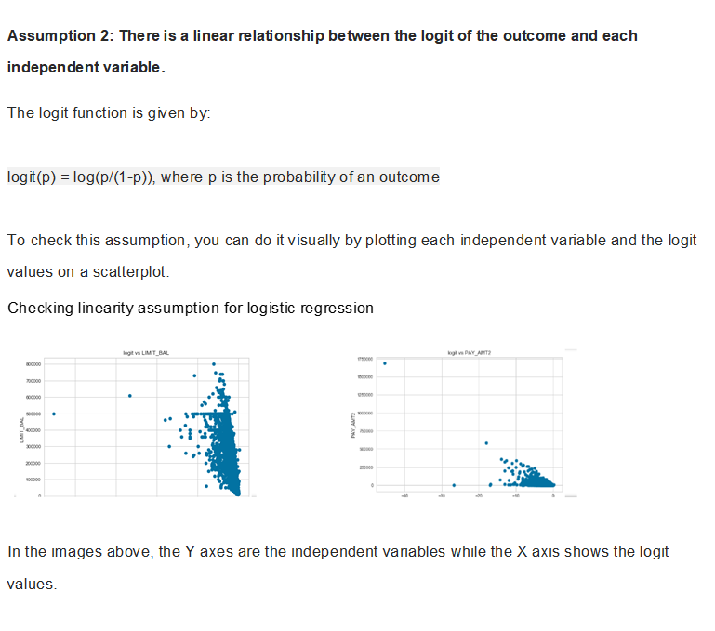
BASE Algorithm Evaluation
We have found most of the variables to full this assumption and the rest we will work on after checking the base line results
20

Slide 30
BASE Algorithm Evaluation
Assumption 3: No Multicollinearity
Multicollinearity refers to the high correlation between your independent variables.
Multicollinearity is a problem because it creates redundant information that will cause the results of your regression model to be unreliable.
To circumvent this issue, we remove independent variables with high Variance Inflation Factor (VIF)*. As a general rule of thumb a VIF > 10 is a strong indication of multicollinearity.
*VIF = 1 ÷ (1-R²)
For our dataset we used vif to remove multicolinearity.
20

Slide 31
Assumption 4: No Influential Outliers
Influential outliers are extreme data points that affect the quality of the logistic regression model. Not all outliers are influential. we need to check for which points are the influential ones before removing or transforming them for analysis.
To check for outliers, we can run Cook’s Distance on the data values. A high Cook’s Distance value indicates outliers.
BASE Algorithm Evaluation
20

Slide 32
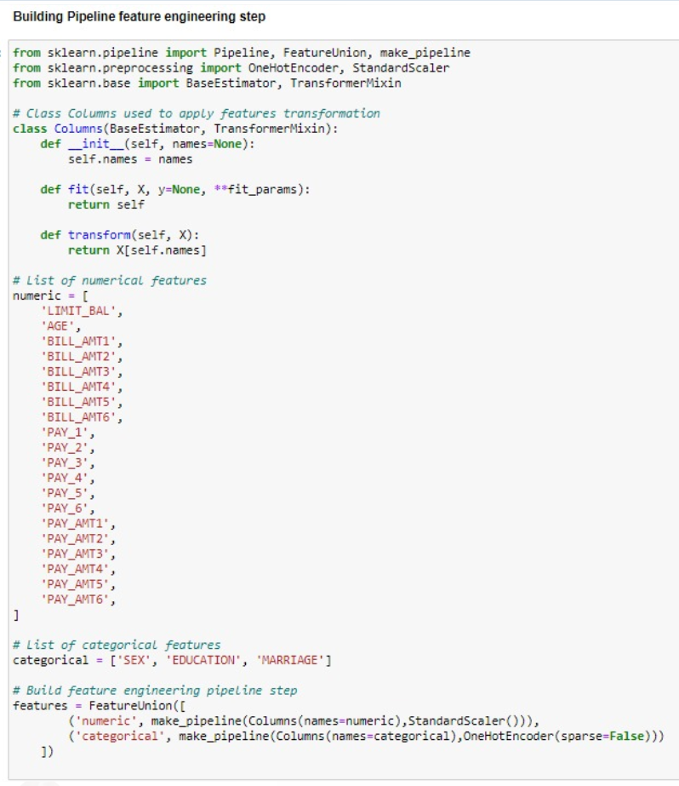

Slide 33
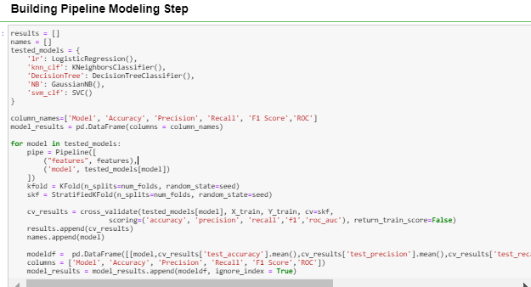
Points we considered when making the pipeline:
As the target variable is imbalanced, to get a constant ratio for the different folds we use stratified Kfold
Cross validation
We choose accuracy, precision, recall, f1-score, roc_auc as the scoring metrics.

Slide 34

MODEL RESULTS
BASELINE
Model Evaluation Metric :
Accuracy would not be an accurate metric to use to evaluate how each model performs over one another.
F1 score will be used instead. We have chosen to evaluate the models based on their F1 score because it considers both precision and recall.
In essence, we can take the F1 score as a harmonic mean of both the precision and recall.
In layman terms, Recall, in the case of credit defaulters refers to: Out of ALL the defaulters (True Positive and False Negatives), how many did our model actually get correct?(positive class)
Precision refers to: Out of all predicted positives what proportion is correctly predicted as positive(True Positives and False Positives)?
Additionally, recall will hold more importance over precision in the case of classifying defaulters, because we want to be able to catch as many potential defaulters as possible so as to not incur losses to the bank.
20

Slide 35
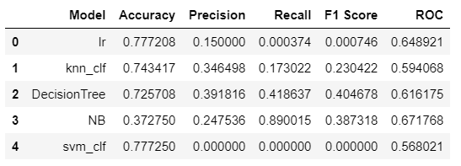
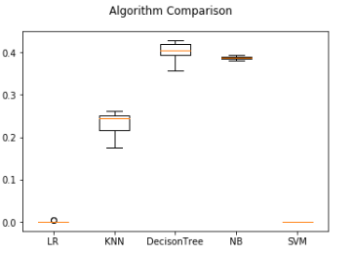
MODEL RESULTS
BASELINE
F1 score Comparison for various algorithms
We observe that logistic regression and svm are having almost nill f1 score
To remedy this we will try smote and then class_weight=balanced
20

Slide 36
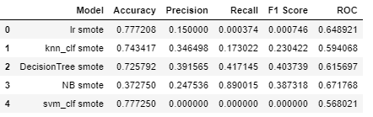
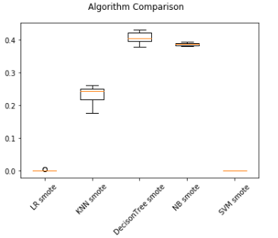
MODEL RESULTS
BASELINE with SMOTE
F1 score Comparison for various algorithms
From the results we can see smote has negligible impact on the original metric scores
So now we will try . class_weight=balanced
20

Slide 37
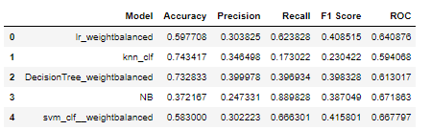
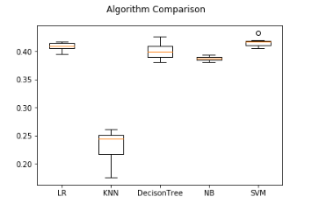
MODEL RESULTS
BASELINE
Weight balanced
F1 score Comparison for various algorithms
The results suggest that Logistic Regression, Decision Tree and SVM are worth further study based on their f1 score
20

Slide 38
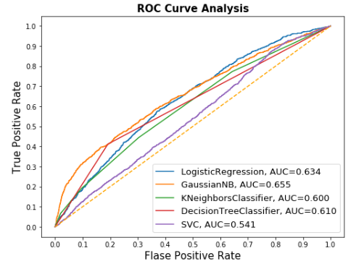
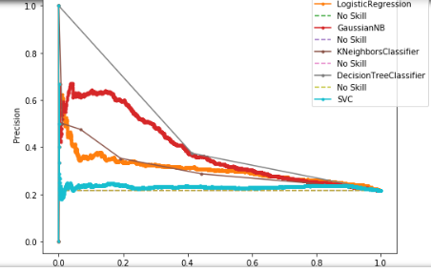
ROC CURVE
&
PRECISON-RECALL CURVE
20

Slide 39
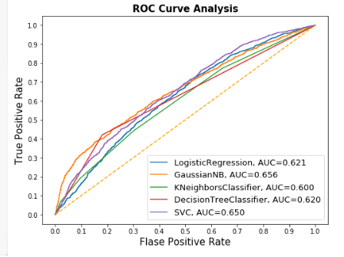
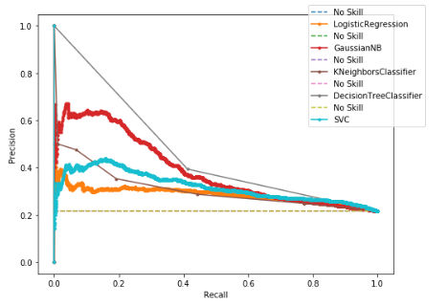
AFTER WEIGHT_BALANCING
ROC CURVE
&
PRECISON-RECALL CURVE
20

Slide 40
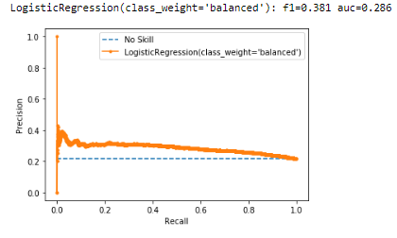
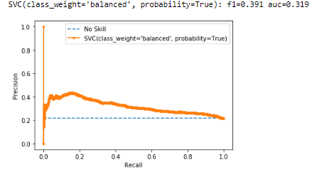
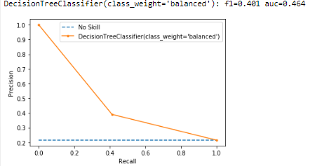
PRECISON-RECALL CURVE
Of best baseline models
20

Slide 41
Future Plans
To add feature engineering like average bill amount, average payment amount
Perform ensemble techniques like Bagging, Boosting and Random Forest classifier and with it also get the important features
Tuning the Hyperparamters for the best performing model among ensemble and base models
Try out Artificial Neural networks also as the best performing model was ANN according to Yeh and Lien research paper.

Slide 42


